Slide 1






*
WATER POTABILITY PREDICTION
BY: RASHMITA MAHAPATRA

Slide 2





INTRODUCTION
Water quality is of vital importance to human health. Having accessible and safe drinking water is a fundamental requirement for maintaining a healthy life.
Ensuring the availability of clean drinking water is a crucial step in preventing diseases and a critical component in improving the overall health of a community.
In this context, data analysis and scientific research related to water quality can provide policymakers with essential insights, helping them formulate effective strategies for water resource management and preservation of water quality.

Slide 3

OBJECTIVE
The primary objective of this machine learning project is to develop a predictive model capable of determining water potability based on key quality parameters.
By analyzing features such as pH, hardness, chloramine concentration, and more, the model aims to provide accurate predictions regarding the safety of drinking water.

Slide 4

Dataset Overview
DATASET OVERVIEW
The dataset encompasses various water quality parameters crucial for assessing potability.
Key features include pH levels, hardness, chloramine, sulfate concentration, conductivity, organic carbon, trihalomethanes, turbidity, and the potability indicator.
These parameters offer a comprehensive insight into water safety.

Slide 5
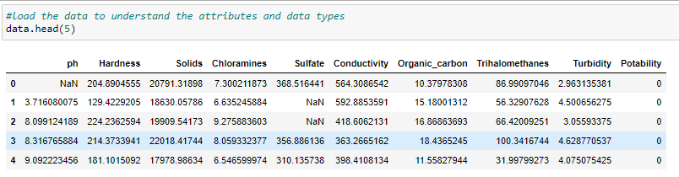
Exploratory Data Analysis
EXPLORATORY DATA ANALYSIS
Let’s have a look at the data:
This dataset has 3276, data points and 10features along with their target label. The first 5 rows appeared as shown above.

Slide 6
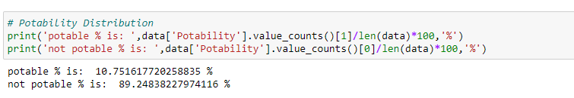
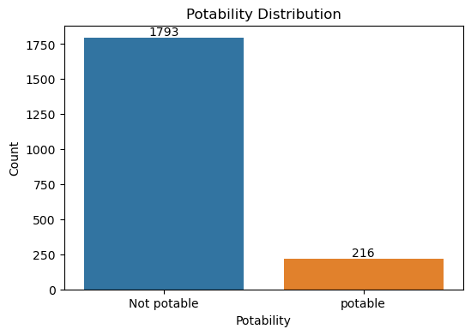
Exploratory Data Analysis
EXPLORATORY DATA ANALYSIS
Distribution of classes
The percentage of potable water instances in our dataset is 10.75%, while the percentage of non-potable water instances is 89.25%. This indicates an imbalance in the data distribution. we need to consider this in our modeling

Slide 7
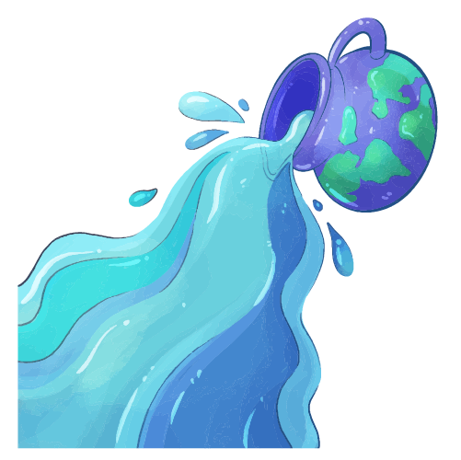
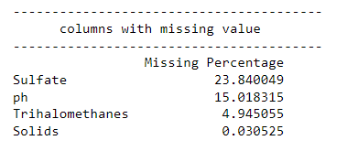
Exploratory Data Analysis
EXPLORATORY DATA ANALYSIS
Missing values
In our dataset, there are missing values present in the columns for Sulfate, pH, Trihalomethanes, and Solids. Notably, the Sulfate and pH columns exhibit a higher prevalence of missing values compared to the others.

Slide 8
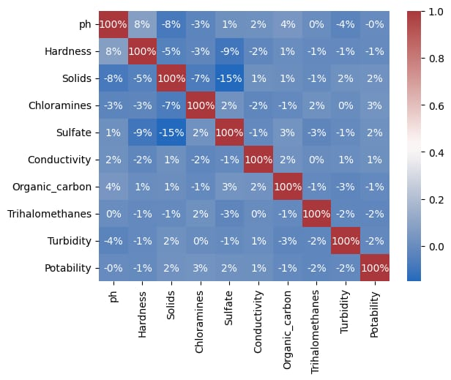
Exploratory Data Analysis
EXPLORATORY DATA ANALYSIS
Correlation of numeric features

Slide 9
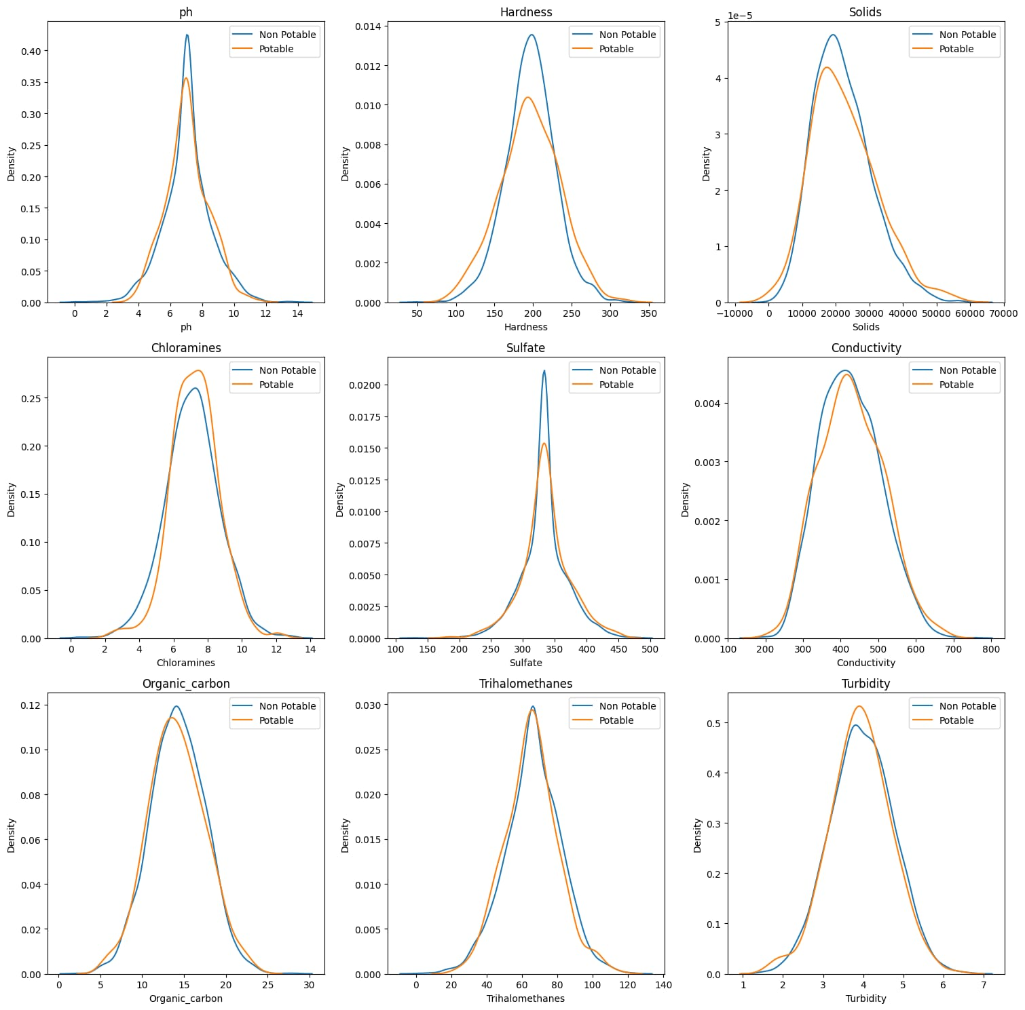
Exploratory Data Analysis
EXPLORATORY DATA ANALYSIS
Both potable and non potable samples have similar kind of normal distributions.

Slide 10
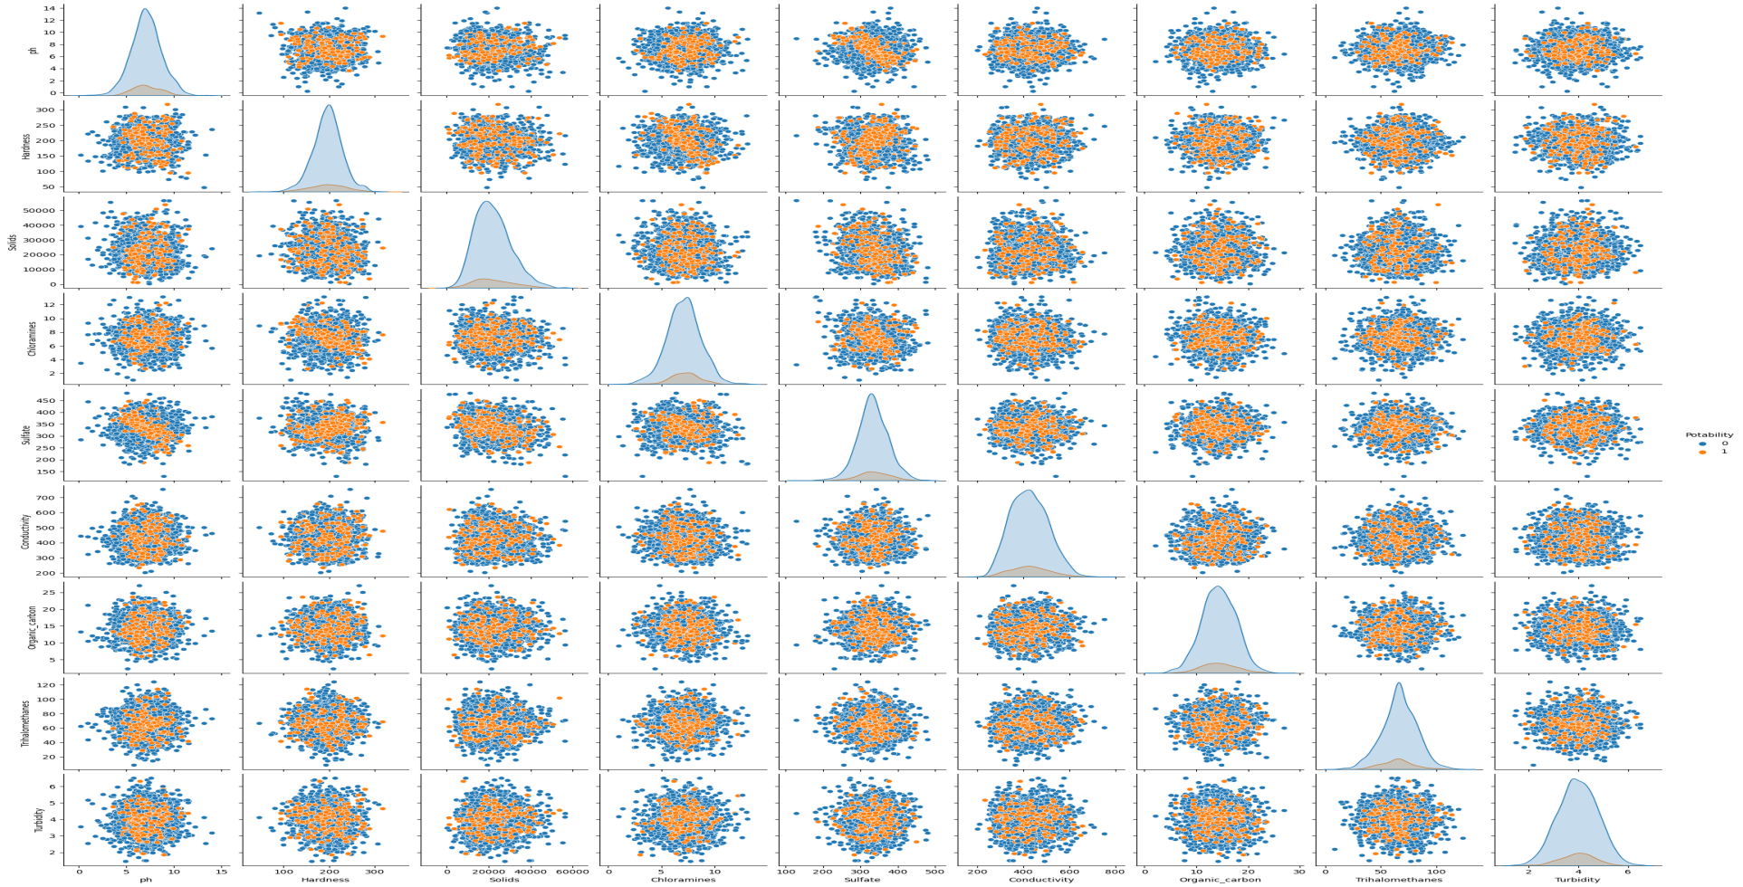
Exploratory Data Analysis
EXPLORATORY DATA ANALYSIS
None of the pairwise correlations are linear in nature, shows no linear relations among the parameters. Potable water sample are always clustured in the middle of the plots.

Slide 11
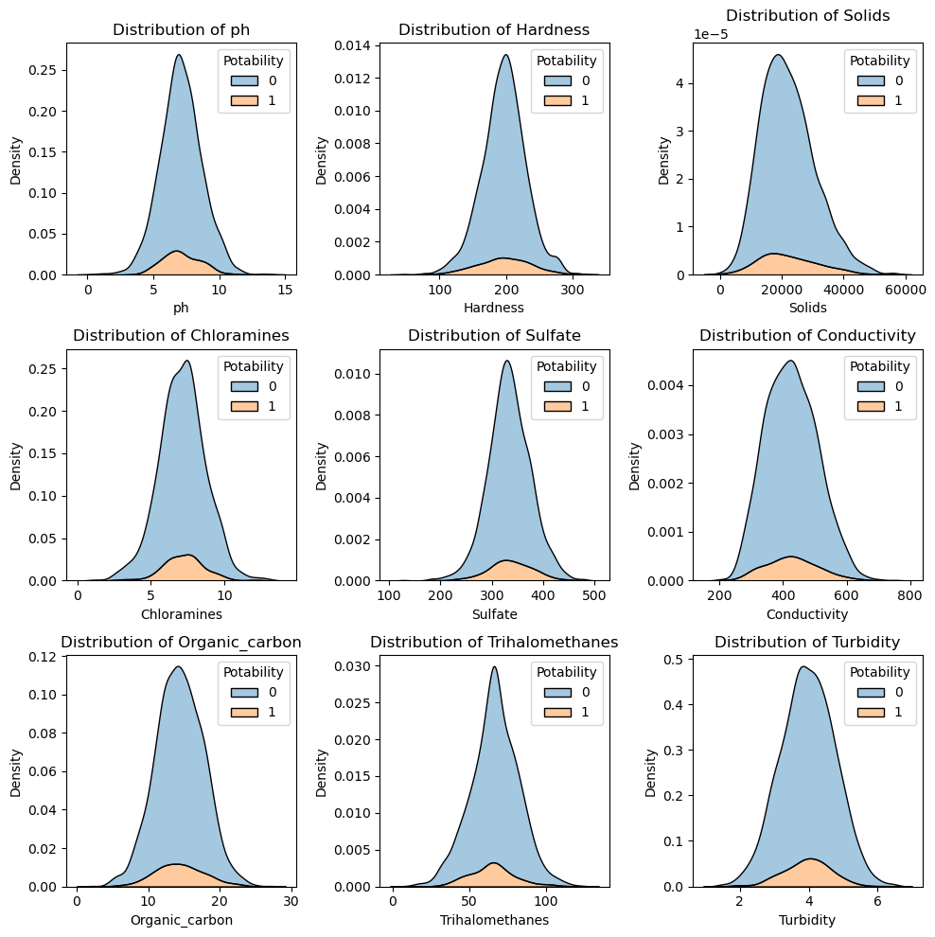
Exploratory Data Analysis
EXPLORATORY DATA ANALYSIS
The analysis of distributions reveals that Chloramines, Sulphate, pH, Trihalomethanes, Organic carbon, Hardness, and Turbidity exhibit a relatively uniform distribution pattern.

Slide 12
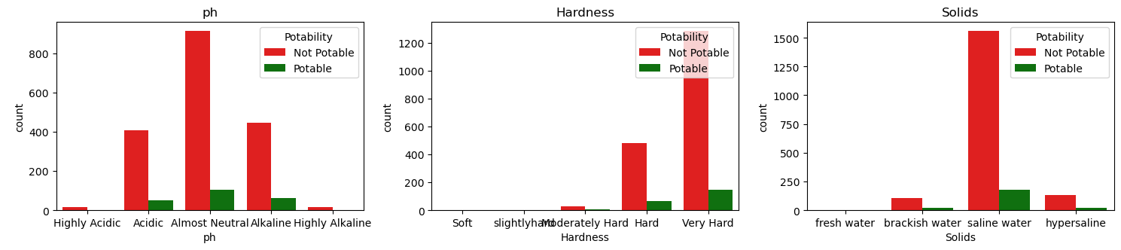
Exploratory Data Analysis
EXPLORATORY DATA ANALYSIS
pH:The 'Almost Neutral' pH range seems to be the most common in both potable and not potable water, indicating that pH alone might not be a strong predictor of water potability.
Hardness:Both Potable and Not Potable water exhibit a predominant presence in the Very Hard and Hard categories.this should not be true.
solids: it seems most of the water bodies are saline.fresh water bodies presence in potable category is zero,this is too wrong.

Slide 13
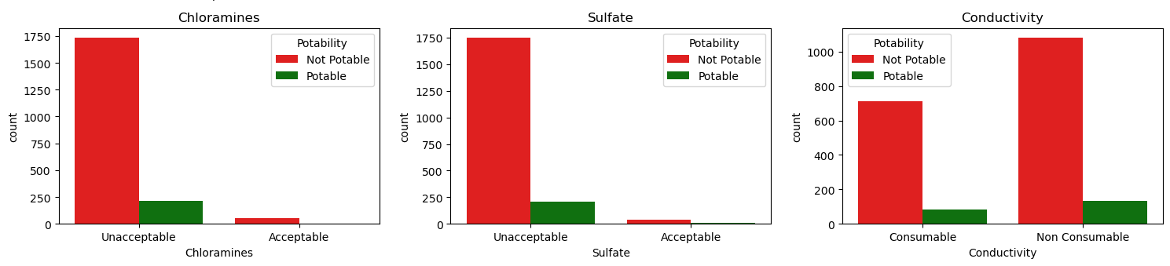
Exploratory Data Analysis
EXPLORATORY DATA ANALYSIS
chloramine,sulphate,organic_carbon,conductivity: most of the potable water bodies have unacceptable chloramine,sulphate,organic_carbon and conductivity values.

Slide 14
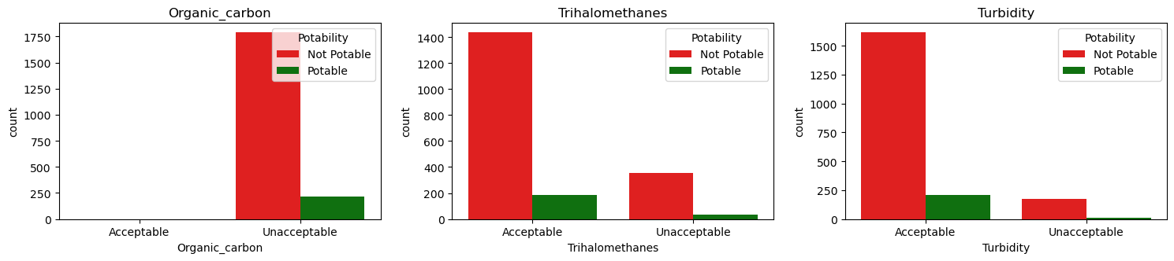
Exploratory Data Analysis
EXPLORATORY DATA ANALYSIS
Trihalomethanes,Turbidity: Acceptable levels of Trihalomethanes and Turbidity dominate in Potable water, indicating that, in general, the Trihalomethanes and Turbidity content is within permissible limits for drinking water.

Slide 15
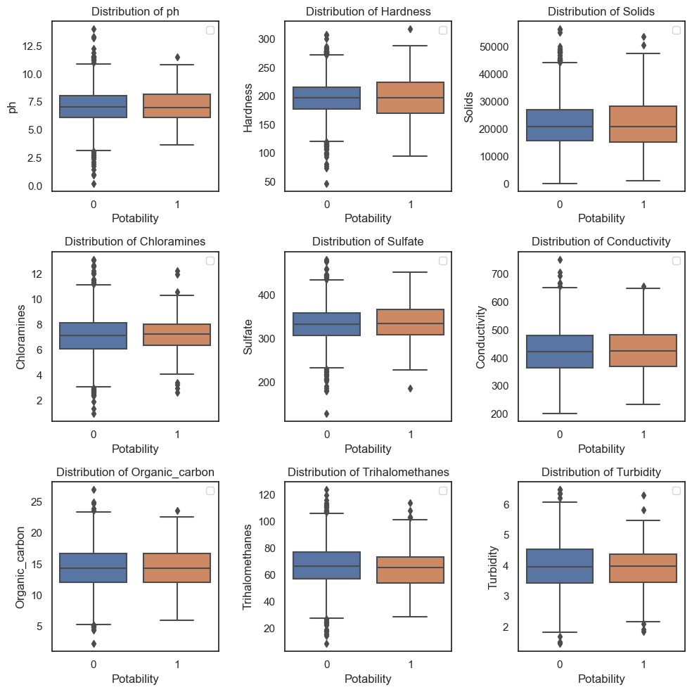
Exploratory Data Analysis
EXPLORATORY DATA ANALYSIS

Slide 16
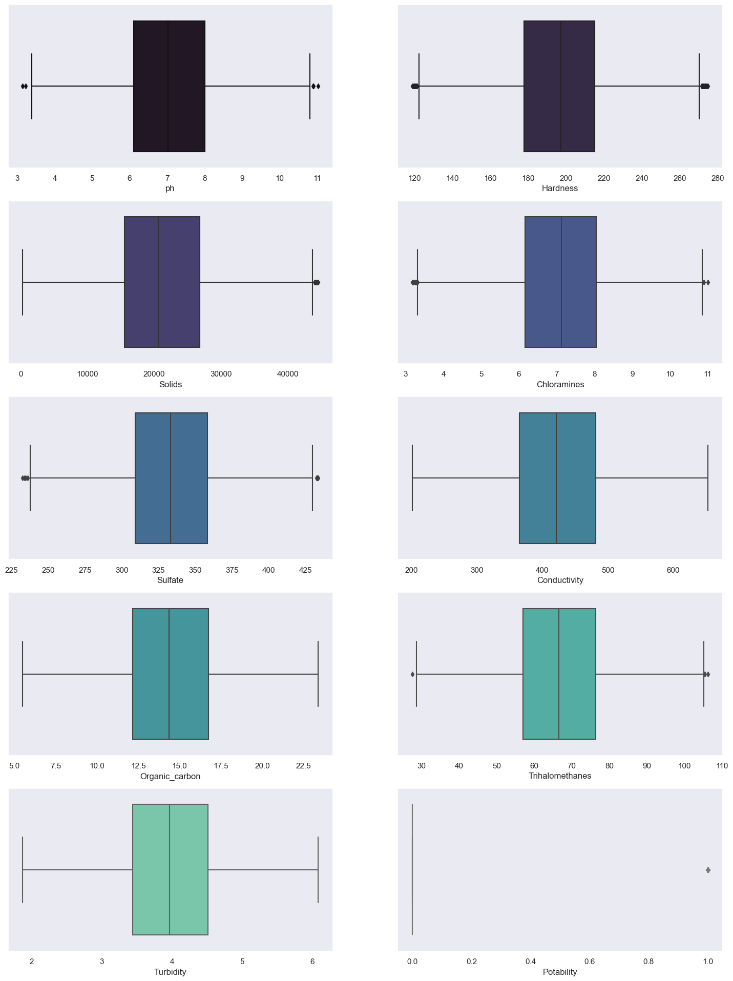
Exploratory Data Analysis
EXPLORATORY DATA ANALYSIS
Following the outlier treatment, a minimal number of outliers persist in the dataset.

Slide 17
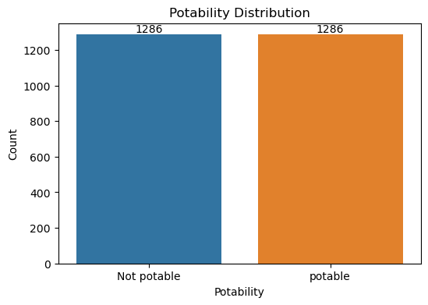



DATA PREPROCESSING
After oversampling now our dataset is perfectly balanced.

Slide 18
DATA PREPROCESSING
Data Splitting:
Data splitting is a crucial step in machine learning to evaluate and validate models effectively.
Splitting data into train and test sets.
Data Scaling:
After splitting the dataset into train and test performed Data normalization or scaling to Standardize numeric features.

Slide 19
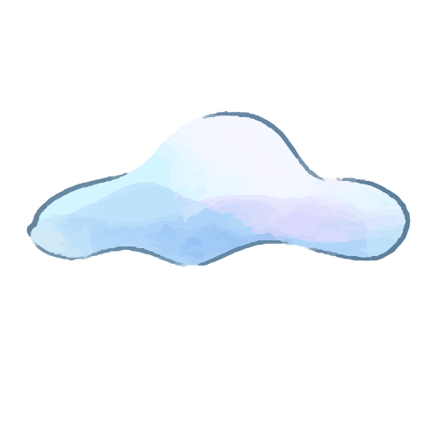
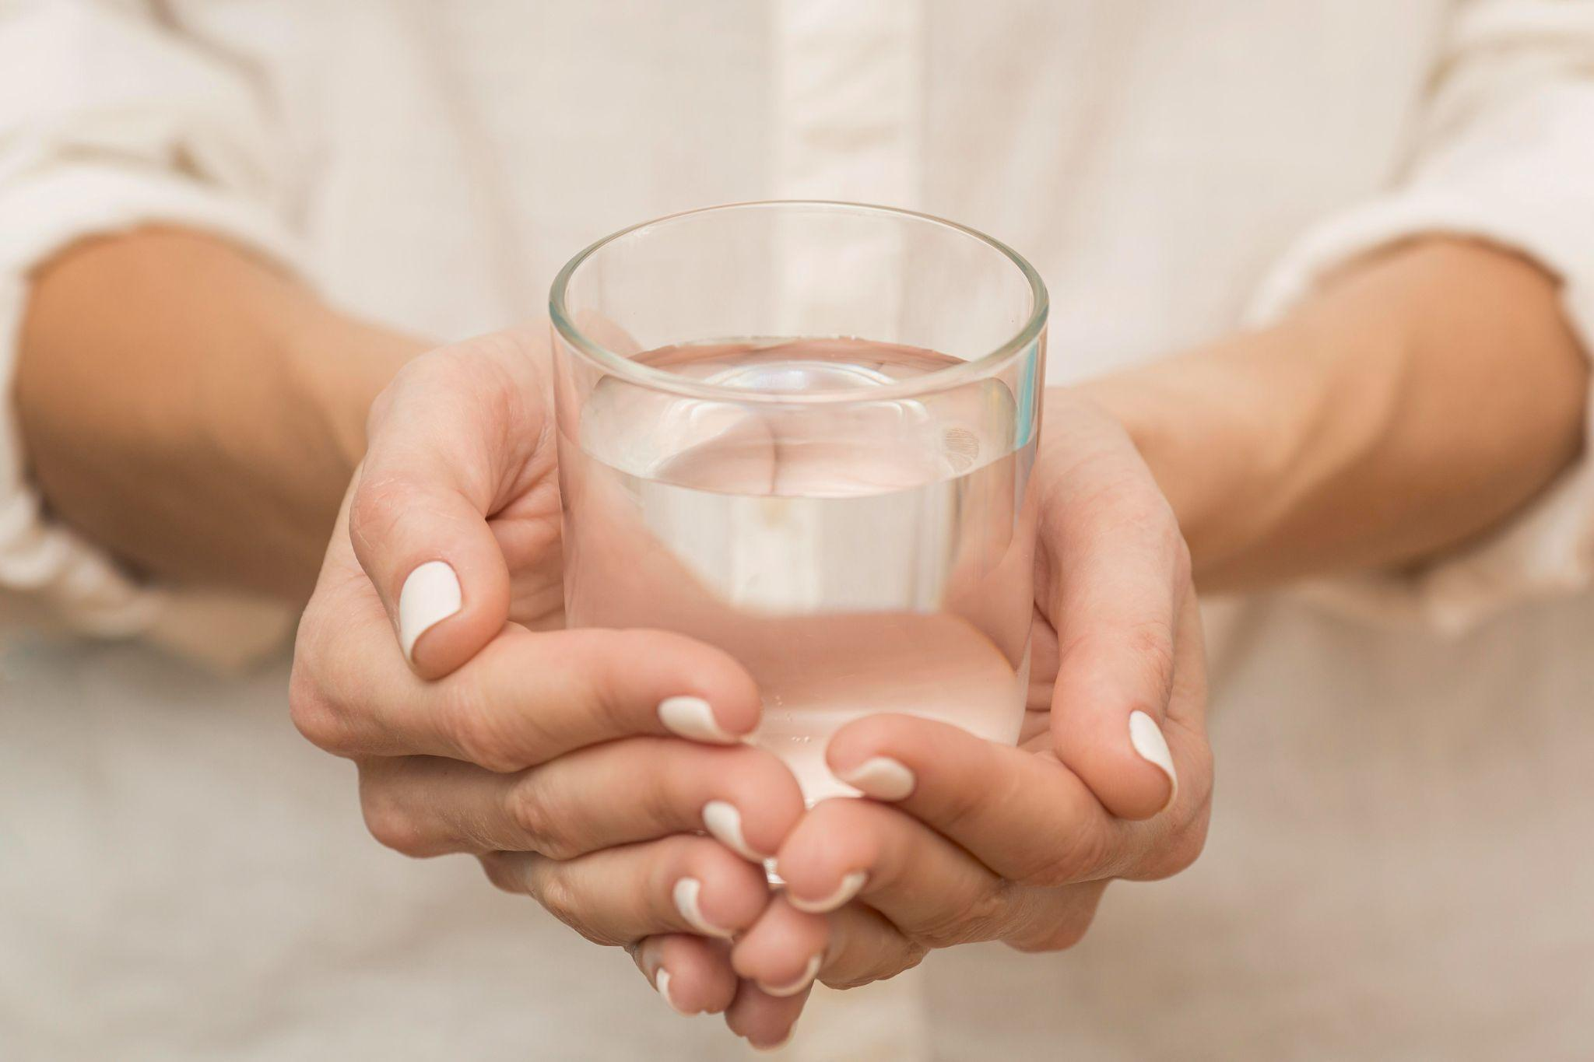
Model Selection
MODEL SELECTION
There are many machine learning algorithms to experiment with when you are working on a classification problem.
Here we are using the following models on our dataset.
AdaBoost
Gradient Boosting
Logistic Regression
Random Forest Classifier
KNN
Xgboost
SVC

Slide 20
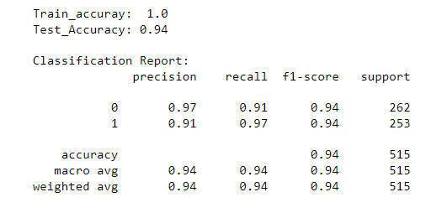
MODEL TRAINING
Now we will plot the table comparing accuracy of each model. .
Plotting accuracy ,F1 score,AUC Table for models.
XGBClassifier model is giving the highest accuracy,f1 score and AUC.
after applying hyperparameter tuning xgb classifier model accuracy increses to 94% . so we for our final model we are going to use xgb classifier with fine tuning.
MODEL | ACCURACY | F1-SCORE | AUC
RANDOM FOREST | 0.91 | 0.92 | 0.972
LOGISTIC REGRESSION | 0.55 | 0.54 | 0.566
XG BOOST | 0.94 | 0.94 | 0.973
KNN | 0.80 | 0.83 | 0.928
GRADIENT BOOSTING | 0.90 | 0.90 | 0.95
Ada BOOST | 0.69 | 0.70 | 0.745
SVC | 0.92 | 0.92 | 0.966

Slide 21
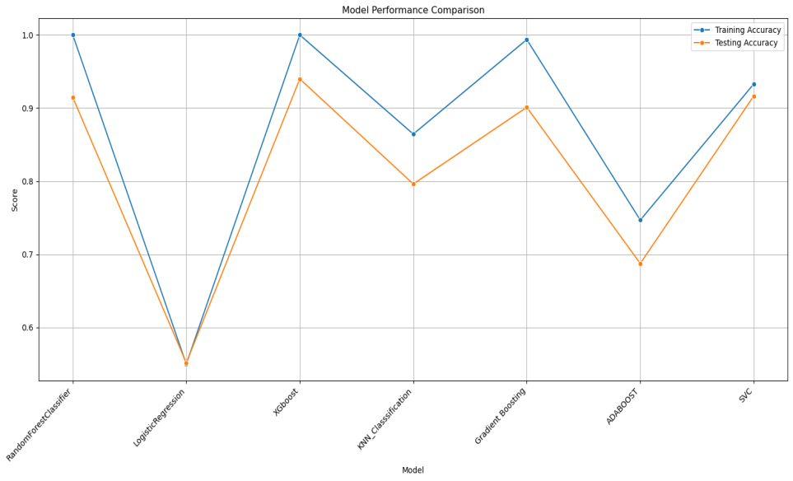
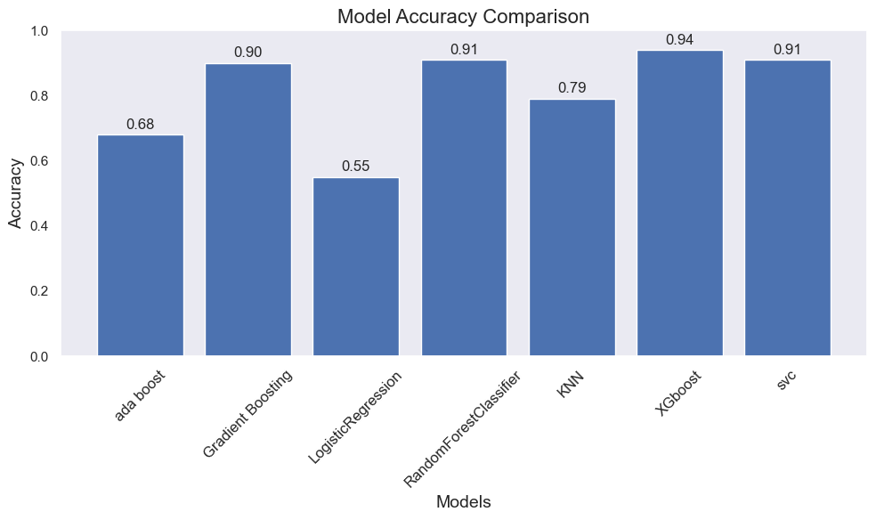
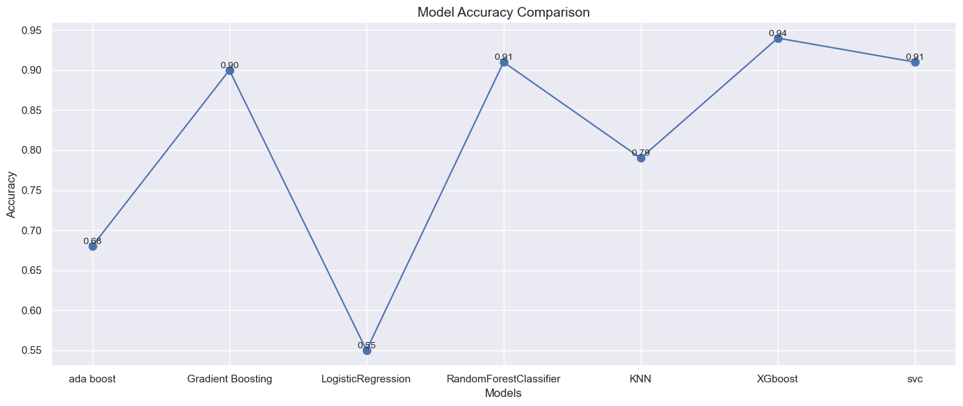
MODEL COMPARISION

Slide 22
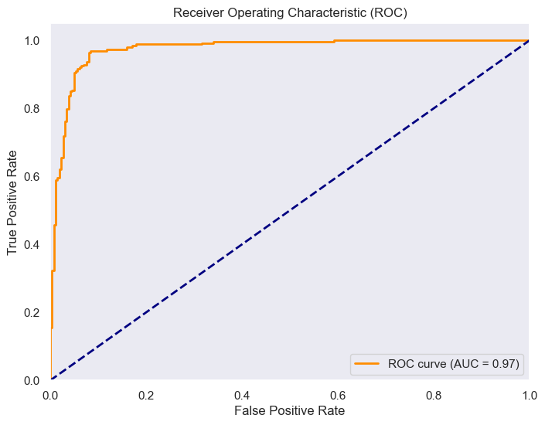
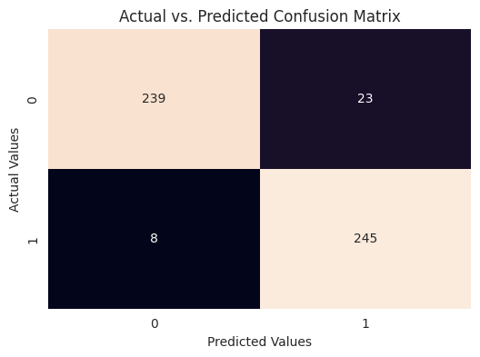
MODEL EVALUATION
The Receiver Operating Characteristic (ROC) curve illustrates the trade-off between the true positive rate (sensitivity) and false positive rate (1-specificity) across different thresholds. With an Area Under the Curve (AUC) of 0.97, our model demonstrates reasonably good discriminative power.
The confusion matrix provides an insight into our model's ability to correctly classify positive and negative instances.

Slide 23
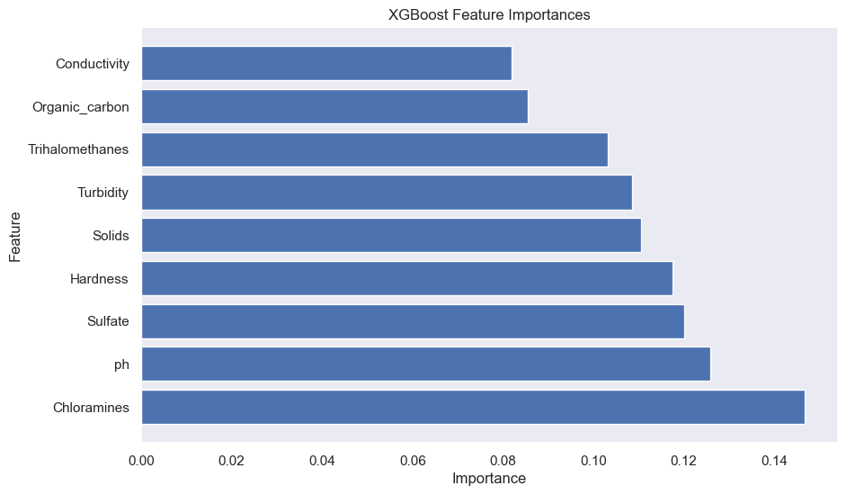
FEATURE IMPORTANCE
Based on the summary plot, it shows that chloramines , ph and sulfate give the most impact on the model decision.

Slide 24
CONCLUSION
CONCLUSION
This water potability prediction project aimed to assess the safety of drinking water based on various water quality parameters.
Model Performance: We explored various machine learning algorithms, Among which, XGBoost yielded the highest accuracy of approximatly 94% on our dataset.
Model Evaluation: We employed evaluation metrics such as Confusion Matrix and the ROC Curve, precision,recall, F1 score. The ROC Curve, with an AUC of 0.97, demonstrated our model's discrimination capability.
Feature Importance: Based on the summary plot, it shows that chloramines , ph and sulfate give the most impact on the model decision.
Continual Improvement: While achieving a 94% accuracy is promising, there's room for improvement. We can further fine-tune hyperparameters, explore feature engineering techniques, or consider ensemble methods to enhance model performance.

Slide 25

THANK YOU

